Slide 1
a
116th Senate Split-Network
2
100.0
Color by party (indep = green)
Denote center
Highlight candidate group here + other Dems
Center
2
1
b
Republican Split-Network
c
Democrat* Split-Network
1

Slide 2
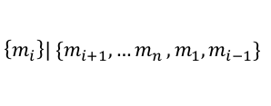
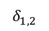
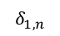
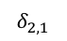
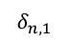
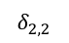
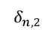
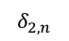
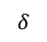
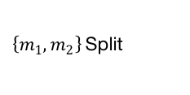
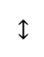
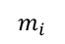
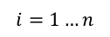
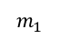
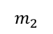
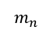
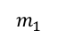
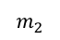
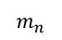
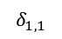
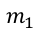
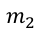
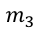
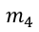
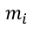
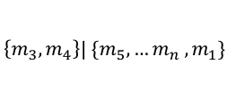
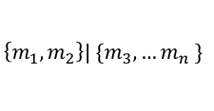
$$M=$$
Set of senators
$$m_{i}$$
for
$$i=1…n$$
$$m_{1}$$
…
$$m_{2}$$
Input
…
$$δ$$
$$m_{1}$$
$$m_{2}$$
$$m_{n}$$
$$m_{3}$$
$\left\{m_{1},m_{2}\right\}$Split
$$m_{1}$$
$$δ_{1,1}$$
$$δ_{1,2}$$
…
$$δ_{1,n}$$
$$↔$$
…
Circular
Split System
$$m_{i}$$
$$\left\{m_{1},m_{2}\right\}| \{m_{3},{…m}_{n}\}$$
$$m_{2}$$
$$δ_{2,1}$$
$$δ_{2,2}$$
$$δ_{2,n}$$
$$m_{4}$$
…
…
…
$$m_{n}$$
$$δ_{n,1}$$
$$δ_{n,2}$$
$$\left\{m_{i}\right\}| \{m_{i+1},{…m}_{n},m_{1}, m_{i−1}\}$$
…
$$\left\{m_{3},m_{4}\right\}| \{m_{5},{…m}_{n},m_{1}\}$$

Slide 3
Correlation of L1 and NNet Distances
Who are outliers
Color by within-party + mix (purple)
Set alpha
Subplots for within each party

Slide 4
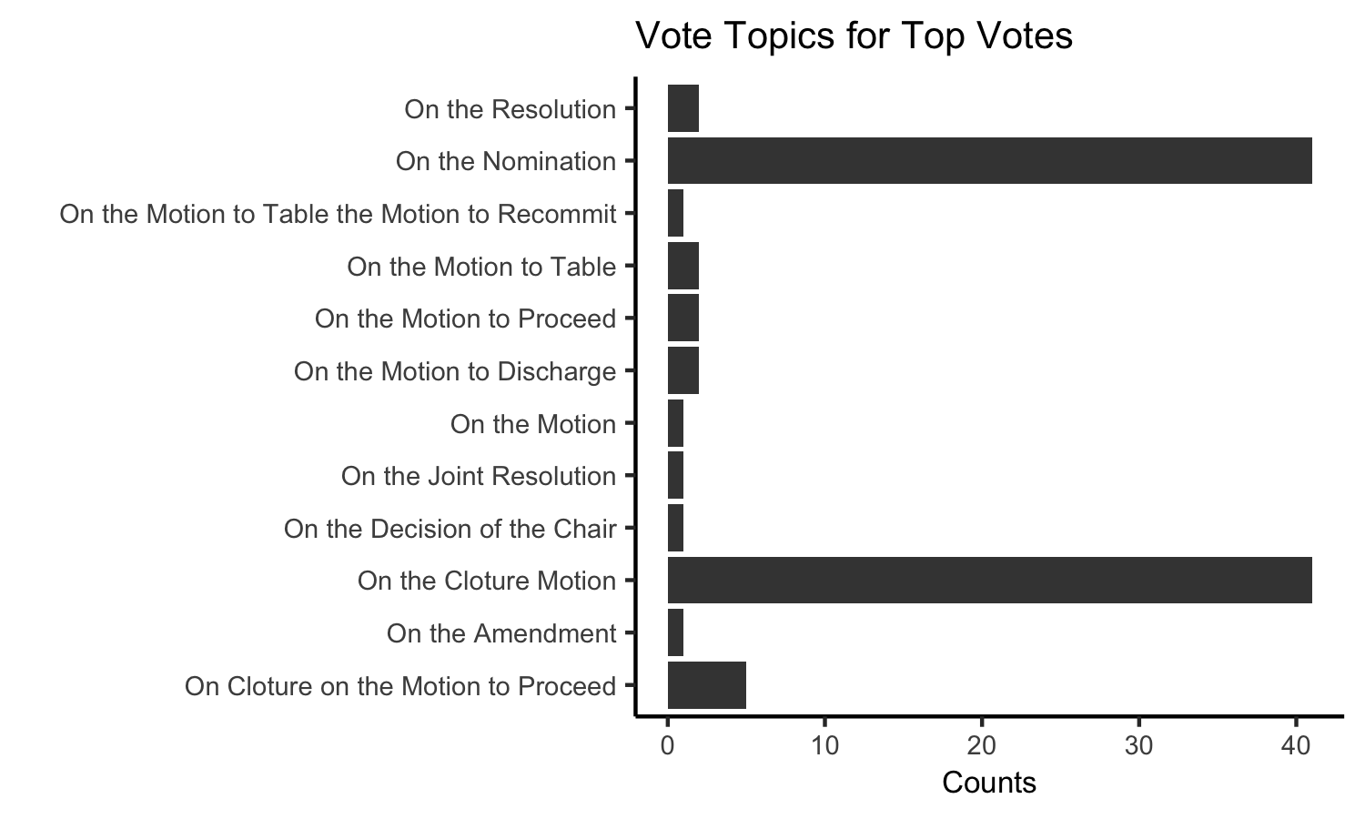
a
Vote Disagreement for Primary Candidates vs Rest
b
a
Remove votes. New splitsTree
Check when votes more than abstentions
P-val with 2x3 (0,1,1/2)
c
06/26/2019 – 01/08/2020
d
c./figures/
P-val
Rank votes + disagreement for other cluster
- Color top 50
Vote desc. for top 50 ranked votes
e
f

Slide 5
a
Party Agreement Over Time
a
‘Center’ Split
Main point is diversity within party
Diversity of vote/behavior
Magnitude difference in current senate
Different levels of unification across parties
b
b
Center
Distance from Center
116th Senators

Slide 6
a
b
All splitsTree plots for members who began part way through term or ended part way (not Kelly, too few points)
Can look at how members in upcoming Georgia election vote
c

